Slide 1


Spatial Stock Assessment Simulation Experiment Webinar Series
Overview and Introduction
October 13, 2022

Slide 2
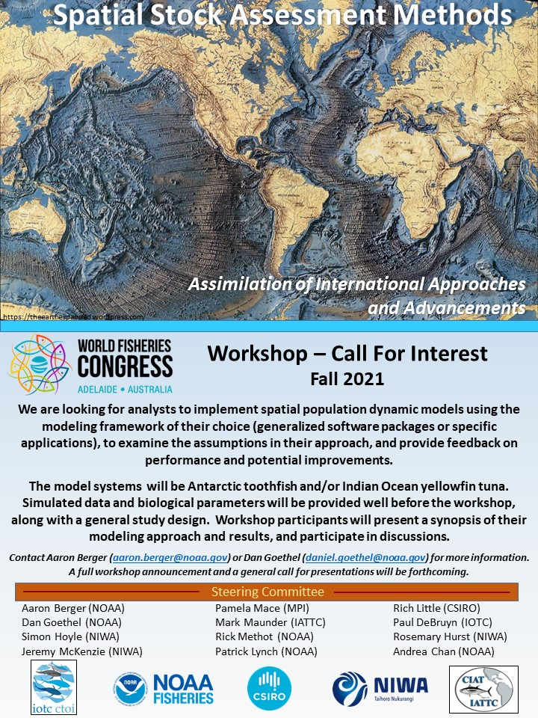
Welcome!
Project Organizers
Aaron Berger, Simon Hoyle, Daniel Goethel, Patrick Lynch, Caren Barceló
Jennifer Devine, Alistair Dunn, Craig Marsh, Jeremy McKenzie, Sophie Mormede
Participants
Contributors
Audience
Project Background: see GitHub site, links in the chat

Slide 3






Webinar Norms
Please make sure you are muted at all times, unless called upon.
Questions/comments can be made at the end of each webinar or during open discussion. Use the raise hand feature or type in your inquiry in the chat box . The facilitator will call upon you or read the chat aloud. Please avoid side conversations in the chat box.
Turn on video camera when speaking. If you are experiencing low bandwidth issues, try using the turn off incoming video feature.
Webinars will be recorded and provided to participants (youtube), as will links to slide decks, shortly after each webinar concludes.
Be respectful and kind, assume positive intent.

Slide 4
Spatial Stock Assessment Methods
A wide range of methods and assumptions can be applied to modeling spatial dynamics.
The methods that assessment packages use to model spatial dynamics are linked to the species/situations encountered by the agency sponsoring the package.
The spatial capabilities of software can affect analysts' decision-making, which may affect how analysts interpret population status.
There is currently little guidance about how to identify misspecification of spatial structure, or overcome the operational constraints of enacting spatial stock assessments.

Slide 5
Study Objectives
Objective #1: Discuss best practices in spatial model development by exploring the decision-points an analyst (or team of analysts) encounters for each platform.
Objective #2: Evaluate within-platform performance and the impacts of different spatial configurations by comparing spatial and spatially aggregated models; and
Objective #3: Explore general performance across different categories of spatial models (e.g., non-spatial, spatially-implicit, spatially-stratified, and fully spatiotemporal).

Slide 6

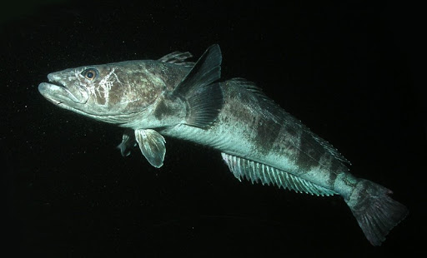
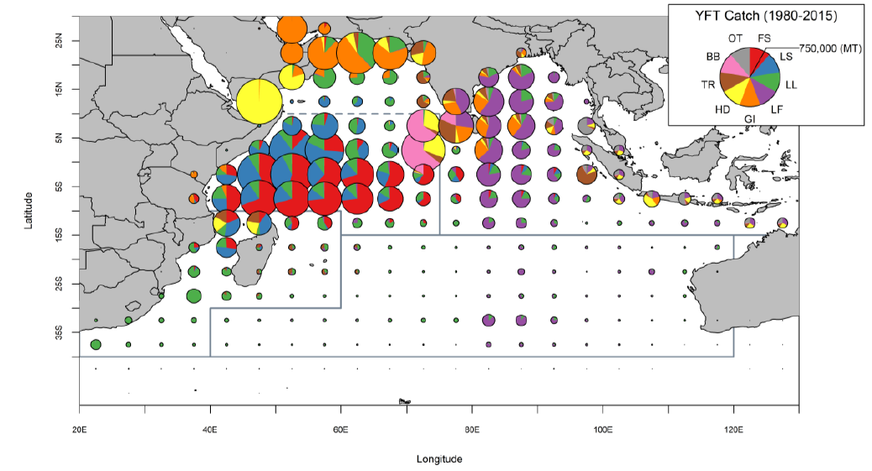
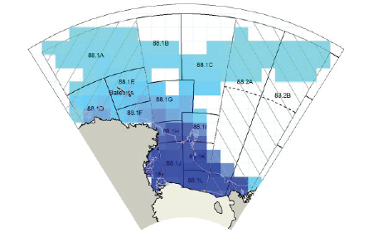
SPM-built Operating Models
Yellowfin Tuna
(YFT; Thunnus albacares)
Antarctic Toothfish
(AT; Dissostichus mawsoni)
wwf.org
Annual spatial movement
Ontogenetic spatial movement
Fu et al. 2018
Simulate fine-scale data sets
Mormede et al. 2020

Slide 7
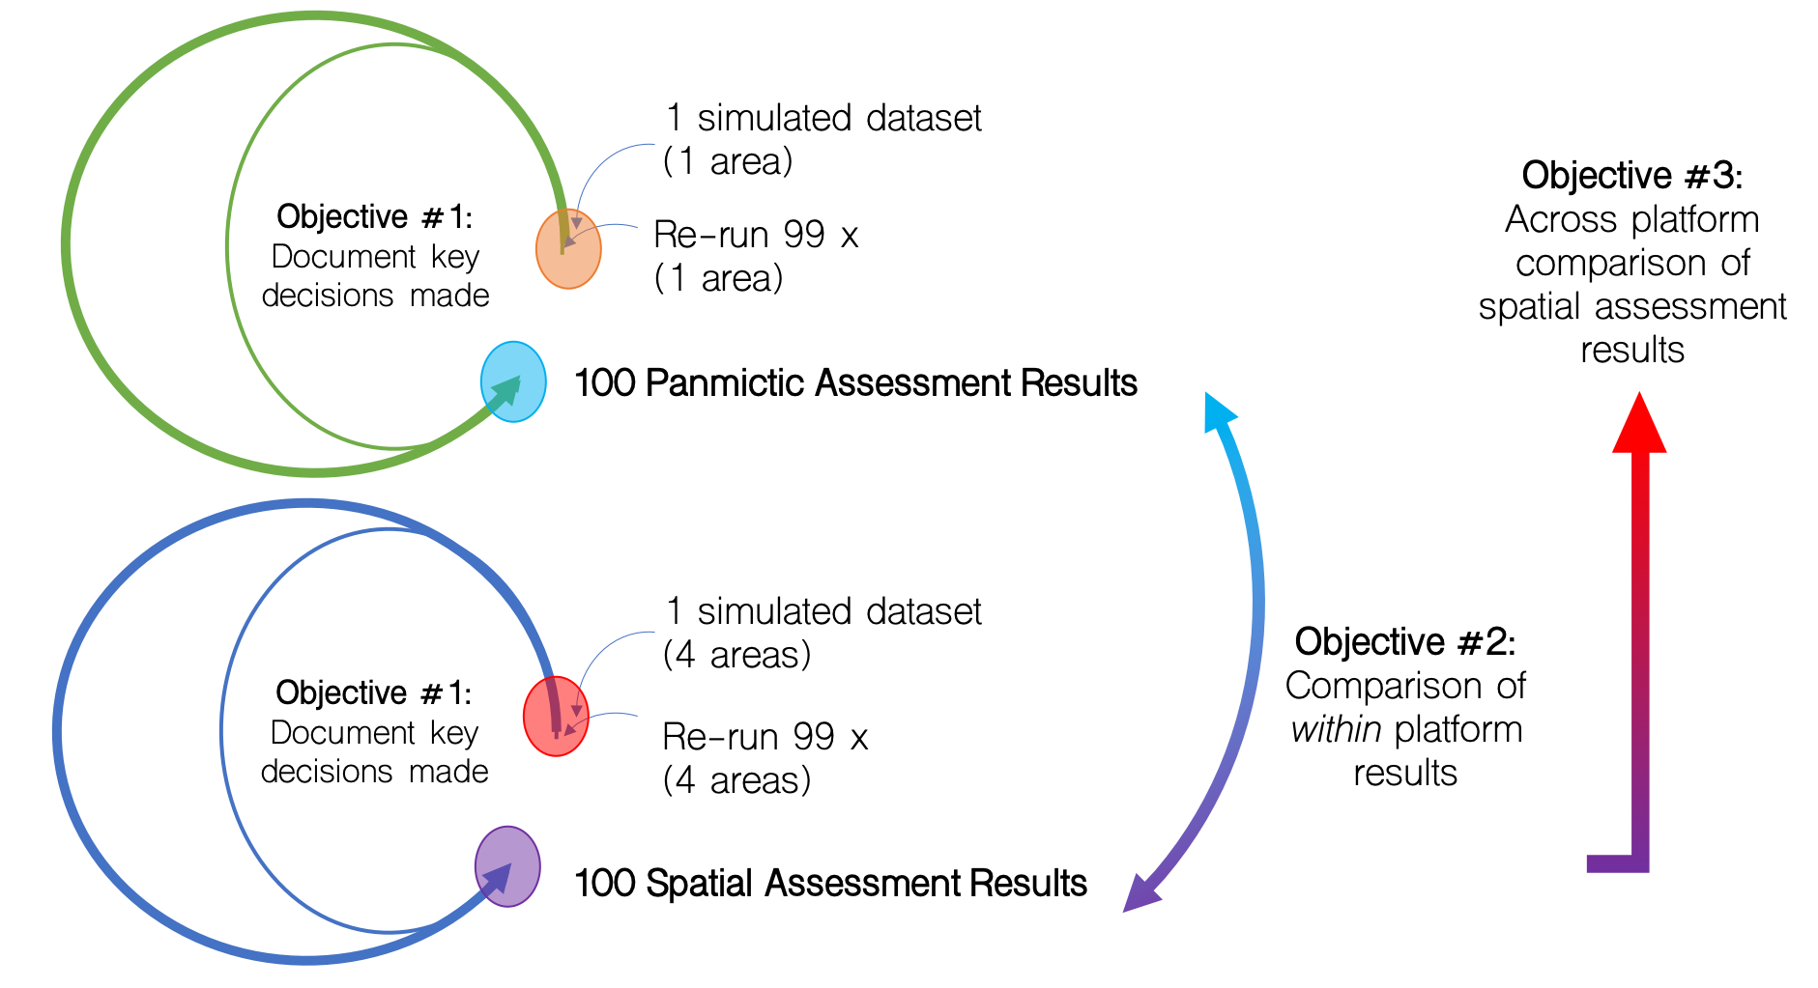
Simulation Experiment: (Base) Study Design

Slide 8
Compiling Results
Standard set of assessment outputs (1 & 4 Area results)
Analysts encouraged to explore alternate aggregations/model parameterizations, time permitting
Decision point analysis
Share how model was developed and why specific decisions were made in the development of the stock assessment, including how platform spatial capabilities (or inabilities?) influenced these decisions
Model diagnostics
Discuss how diagnostic tools were used to determine spatial parametrization
Webinar presentation of results (to date)

Slide 9
Experiment Context
Research assessments developed from this study design are not meant to directly inform operational management.
Research assessments are considered works in progress, and developed ‘pro bono’ as side projects.
Lessons learned inform the scientific process for generating and improving future assessment capabilities.
This simulation experiment is strictly a research endeavor, with the specific fish species chosen as an example to address broad study objectives.
Teams were constructed by software platform, interest, and time availability.

Slide 10
Analyst Teams
CASAL (YFT)
Gadget
Craig Marsh
Teresa A’mar
Jeremy McKenzie
Bjarki Elvarsson
Will Butler
Valerio Bartolino
Alfonso Perez-Rodriguez
SS/VAST-IATTC
Spatiotemporal
Haikun Xu
Carolina Minte-Vera
Mark Maunder
Ji Cao
Maxime Olmos
SPASAM
MFCL
Jon Deroba
Amy Schueller
Brian Langseth
Nicholas Ducharme-Barth
Matt Vincent
John Hampton
Paul Hamer
Arni Magnusson
Claudio Jordan-Castillo
Jemery Day
Thomas Tilak
CASAL2 (TOA)
Arnaud Gruss
Sophie Mormede
SS-IOTC
SS-ICES
Massimiliano Cardinale
Dan Fu
Kathryn Doering
Agurtzane Urtizberea
Richard Methot
Maria Grazia Pennino
Francisco Izquierdo
Giancarlo Correa
Marta Cousido Rocha
Notes:
C++ algorithmic stock assessment laboratory;
Globally applicable Area Disaggregated General Ecosystem Toolbox

Slide 11



Key Features
Simulation Experiment
2021 - 2022
Webinar Series
October 2022 – January 2023
Workshop (in person)
March 2023

Slide 12

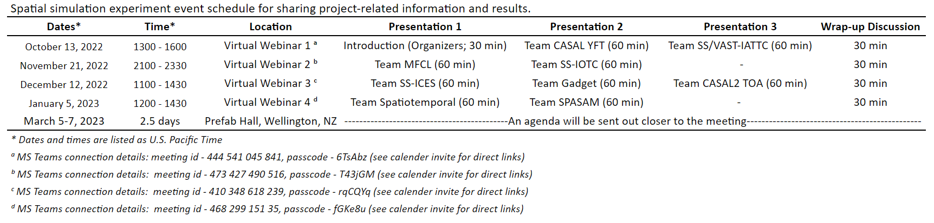
Upcoming Schedule

Slide 13

Workshop Goals
Compare aggregate results across modeling frameworks to understand influence of model structure (panmictic, fleets-as-areas, spatially stratified, spatiotemporal, etc.) on interpretations of spatial dynamics
Further explore and compare how analysts familiar with spatial assessment platforms develop spatial models.
Share experiences and lessons learned from practical applications of spatial stock assessment models among international partners.
Discuss best practices and salient features of the next generation of spatial models.
Create recommendations for operationalizing spatial stock assessment models into fisheries management frameworks.
- - - - - - - A forum for presentation, discussion, and recommendation - - - - - - -

Slide 14
Webinars – Some Discussion Questions
Spatial data
What data types are needed to fit spatial stock assessments?
What novel or unique data types could help to parametrize spatial models?
Spatial modelling capabilities
Which were the most useful/important for you?
Were there options that would have been useful but were unavailable?
What limits current spatial assessment platforms, and how might these be overcome?
Model diagnostics
What types of diagnostic tools and residual analyses are useful for identifying when spatial processes need to be incorporated into a stock assessment?
How did you arrive at final model parameterization?
Management
What factors limit wider implementation of spatially explicit stock assessments, and how might these be addressed in the future?
How can biological reference points that adequately account for spatial structure be developed?

Slide 15





Thank you for your participation and attention!
Github resources
Main site: https://github.com/aaronmberger-nwfsc/
Spatial-Assessment-Modeling-Workshop
Check out background
documentation (docs)
and guidance articles!
Pkgdown: https://aaronmberger-nwfsc.github.io/
Spatial-Assessment-Modeling-Workshop/

Slide 16

Questions
“Time and space are not conditions of existence, time and space is a model for thinking.”
- Einstein

